Slide 1
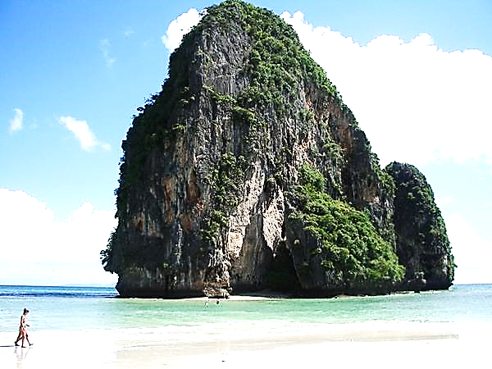
ROCK
Dads

Slide 2
Note: Any videos in this presentation will only play online. After you download the slideshow, you will need to also download the videos from YouTube & add them back into your PowerPoint.
We present these messages at Bee Creek Park in College Station, TX. If you would like to watch the video of the service with this message, click here:
http://campaignkerusso.org/?p=13167
We would love to know more about the people who download our lessons & sermons. We invite you to email us & let us know where & how you use them.
info@campaignkerusso.org

Slide 3
ROCK
Dads

Slide 4
A Rock Shows-Up
Present, In the Moment & Dependable
God always shows up.
He never lets his children down.

Slide 5
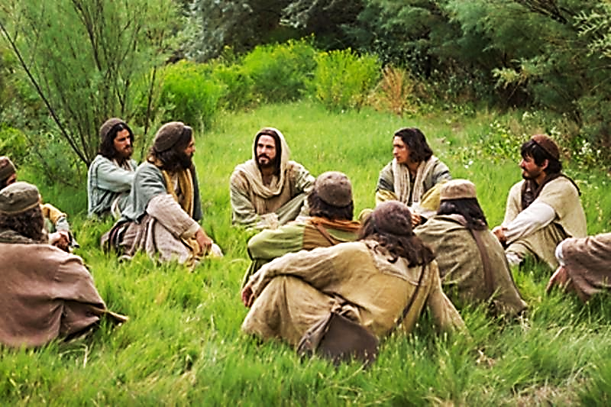
“Whenever two or three of you come together in my name, I am there with you.” Mat. 18:20 (CEV)

Slide 6
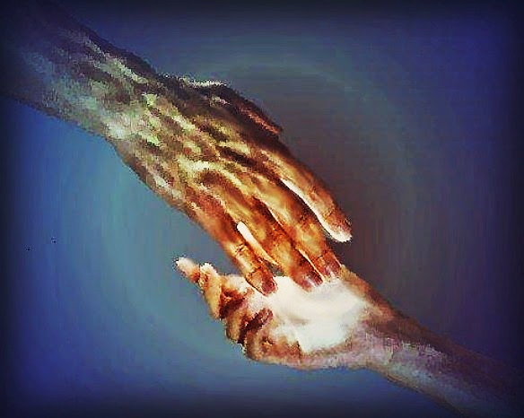
“Don’t be afraid. Look, your God will come.”
Isa. 35:3 (ICB)
Make the weak hands strong. Make the weak knees strong. Say to people who are afraid and confused,

Slide 8
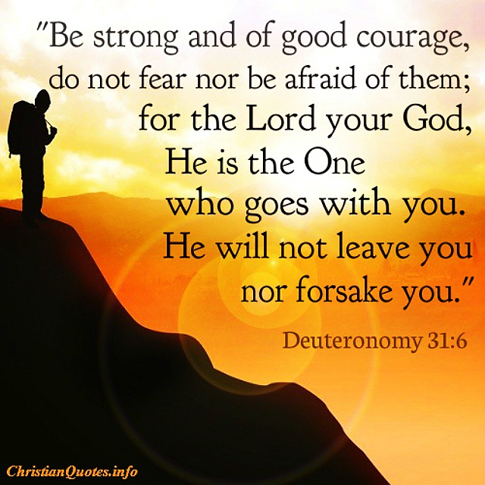

Slide 10
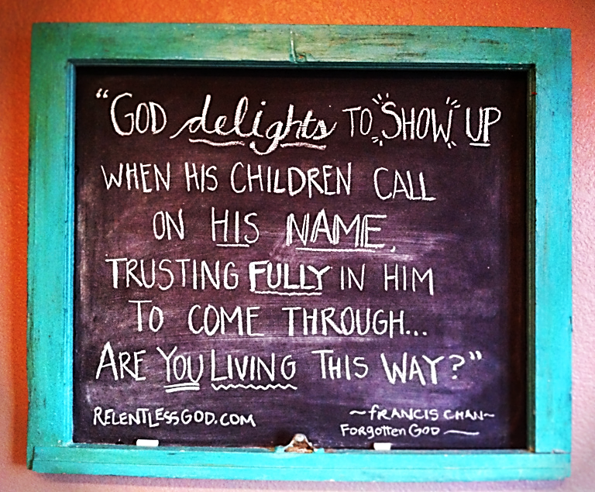

Slide 11
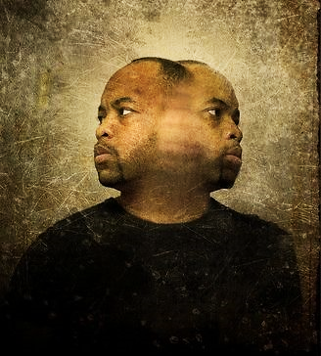
Sadly, double minded men often don’t show up
for God, family, or anyone else.
You can’t depend on them.
A double minded man is unstable in all his ways.
James 1:8 (KJV)

Slide 12
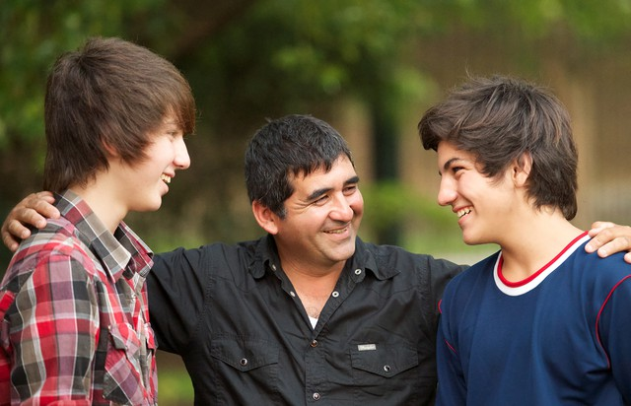

Slide 13
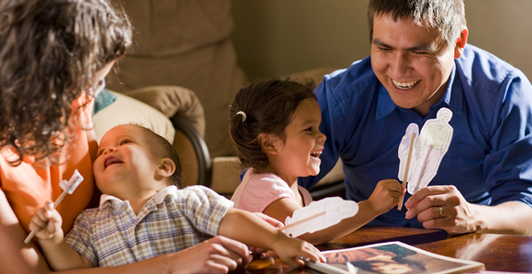

Slide 14
A Rock Stands-Up
Integrity
Be a
Stand-Up
Guy
God is true to His word.
He is exactly who He says He is.

Slide 16
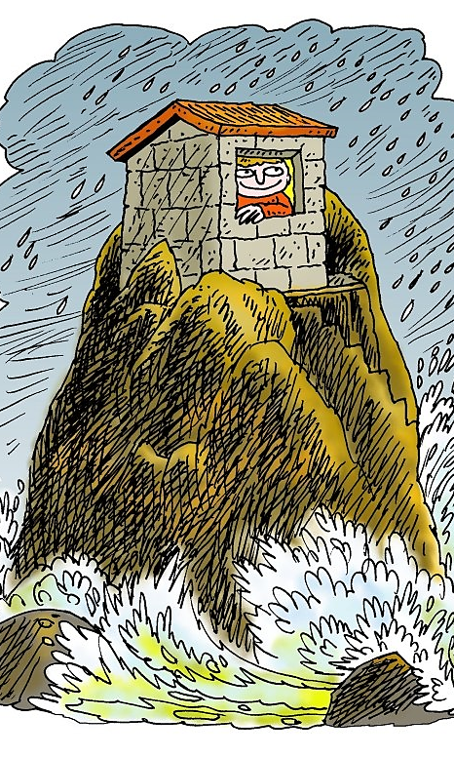
How to Be a Stand-Up Guy:
“Whoever hears these teachings of mine and obeys them is like a wise man who built his house on rock. It rained hard, the floods came, and the winds blew and beat against that house. But it did not fall because it was built on rock.” Mat. 7:24, 25

Slide 17
“Sinners are destroyed and taken away. But the houses of godly people stand firm.” Prov. 12:7 (NIRV)
When the storms of life come, the wicked are whirled away, but the godly have a lasting foundation. Prov. 10:25 (NLT)

Slide 18
A man’s family needs for him to be a Real Stand-Up Guy—
A Man of Integrity!

Slide 19
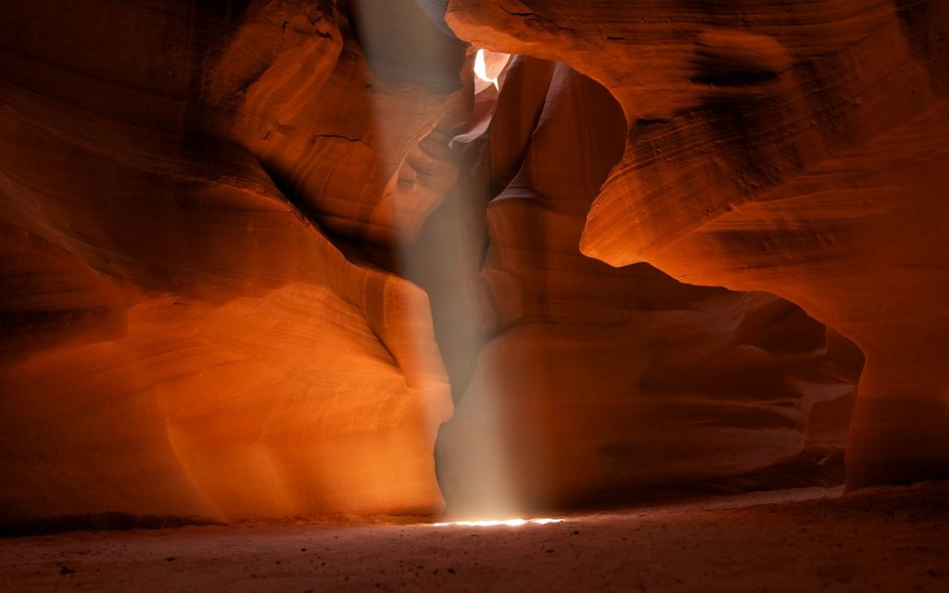
A rock will
Step-Up
to
Protect
&
Provide for His Family

Slide 20
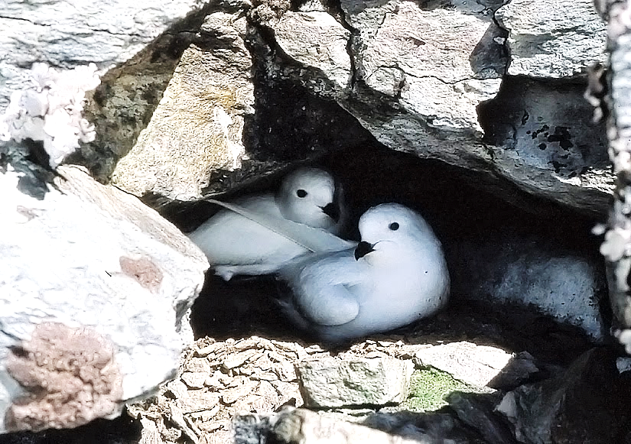
God Protects Us
“Be my rock of safety where I can always hide.” Ps. 71:3

Slide 21
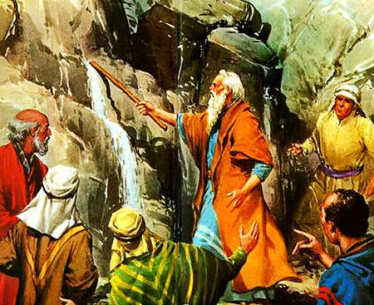
Provide for Them
"…and you shall strike the rock, and water will come out of it, that the people may drink."
Ex. 17:6

Slide 22
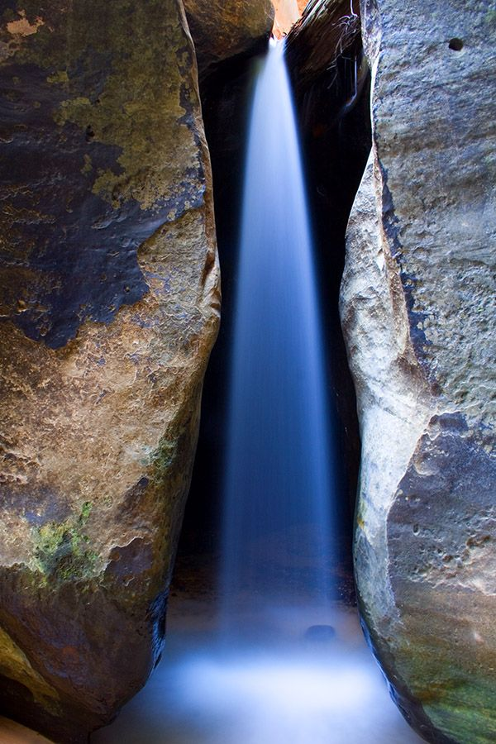
The rock provides & protects at great personal cost to itself. It is said to be “struck,” “cleft” and “split.”
“He made water flow for them from the rock; he split the rock and water gushed out.”
Isa. 48:21 (GW)

Slide 23
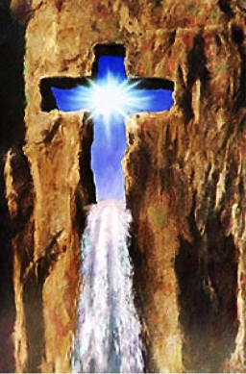
That Rock -struck, cleft & split-
Was Jesus!
"They drank from that spiritual Rock… that Rock was Christ." 1 Cor. 10:4

Slide 24
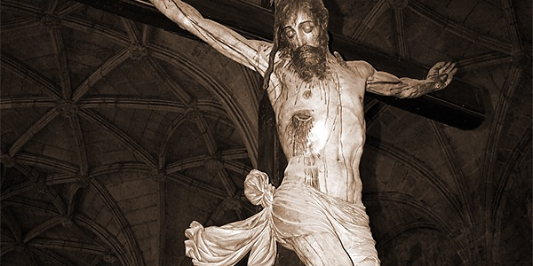
Rock of Ages, cleft for me, let me hide myself in thee.
Let the water and the blood from thy riven side which flowed, be of sin the double cure.

Slide 25
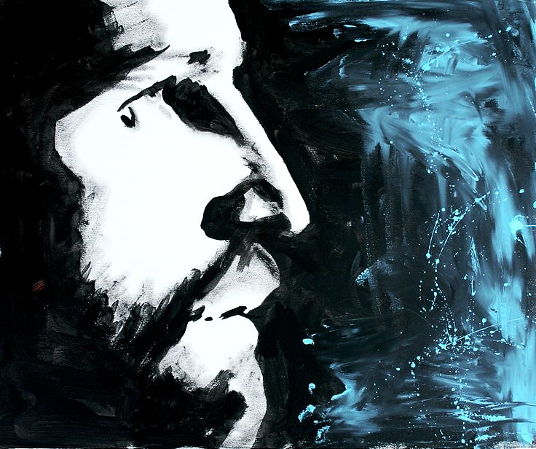
“Jesus stood up and called out in a loud voice, "If anyone is thirsty, let him come to Me and drink.”
John 7:37 (BSB)

Slide 26
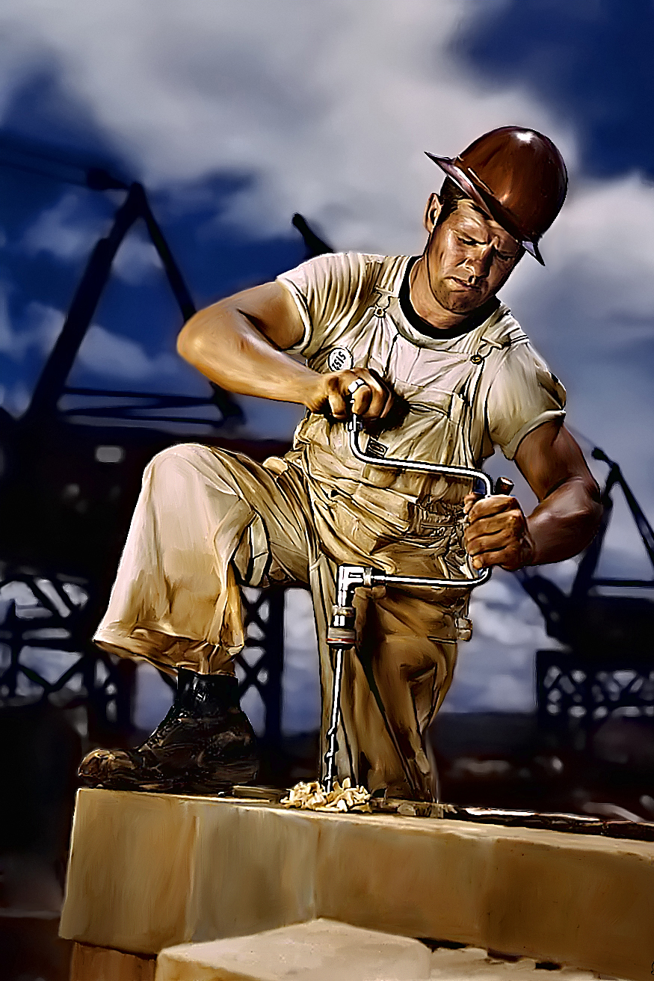
Rock dads provide for & protect their wife and kids, even if it is at great personal cost & sacrifice.
They are (in a sense) “cleft” for their families.

Slide 27
Rock Dads:
Show-Up
(Present & Dependable)
Stand-Up
(Integrity: Even When No One is Looking)
Step-Up
(Provide & Protect Even at Great Personal Cost)

Slide 28
Next Slide - Song: Rock of Ages Download Here: https://youtu.be/gM7gt_cSxjw

Slide 29
Song: Rock of Ages

Slide 30
Is Jesus Speaking to You?
“They said to each other, ‘Did not our hearts burn within us while he talked to us on the road, while he opened to us the Scriptures?’”
John Wesley Said:
“…the preacher was describing the change which God works in the heart through faith in Christ and I felt my heart strangely warmed.”
Jesus makes His presence Known by a small voice!

Slide 32
What is the Sinner‘s Prayer?
This is a prayer we can pray when we are ready to admit we are sinners and need Christ’s forgiveness.
It must be prayed with faith in our hearts and a readiness to have a life-changing encounter with Jesus Christ.

Slide 33
A prayer of faith → Pray this prayer if :
If you never have before
You have in the past, but you think it would mean more today
You have been walking afar off and you want to come back
You want to set an example & show others how it is done
You just like to give your heart to Jesus again & again
Faith

Slide 34
We Declare Our Faith Publicly Because Jesus Declared His LOVE Publicly
“If you stand before others and are willing to say you believe in me, then I will tell my Father in heaven that you belong to me.” Mat 10:32

Slide 35
Important Questions
Do you want to know Jesus as your Savior right now?
Do you believe He died to save you from your sins & that He rose from the dead?
Do you believe that He is here, waiting to save you right now?

Slide 36
The Prayer of a Sinner Turning to Jesus
Dear Jesus, I know that I have sinned against You and that my sins separate me from You.
I am truly sorry.
Right now, I turn away from my sinful past .
Please forgive me, and help me to keep from sin.
I believe You died for my sins.
I Believe You rose from the dead, you are alive, and you hear this prayer from my heart.
I invite You Jesus to be both my Savior and the Lord of my life.
I want You to rule my life from now on.

Slide 37
“But some people did accept him. They believed in him, and he gave them the right to become children of God.”
John 1:12

Slide 39
“If you openly say, ‘Jesus is Lord’ and believe in your heart that God raised him from death, you will be saved.”
Rom. 10:9
What did you learn today?
What have you been thinking about God lately?
What do you want to tell others about Jesus?

Slide 40
“Draw near to God, and He will draw near to you…
Altar Time
…Cleanse your hands, you sinners, and make your hearts pure, you who are half-hearted towards God.” James 4:8 WNT

Slide 41
Close in Prayer

Slide 42
Note: Any videos in this presentation will only play online. After you download the slideshow, you will need to also download the videos from YouTube & add them back into your PowerPoint.
We present these messages at Bee Creek Park in College Station, TX. If you would like to watch the video of the service with this message, click here:
http://campaignkerusso.org/?p=13167
We would love to know more about the people who download our lessons & sermons. We invite you to email us & let us know where & how you use them.
info@campaignkerusso.org

Slide 43
Welcome to Aggieland Faith Family Style Worship

Slide 44
Would You Like Prayer or Bible Study at Your House?
Personal Prayer: We can come to your home & pray with you, or you can email us when you need prayer.
Home Bible Study: We will come to your home & hold a bible study for you & your friends.
Bible Party: We will hold a Kid’s Bible Party: You provide the food & kids - we will do the bible fun & stories.

Slide 45
Would You Like Visitation?
We will visit a friend, loved one in the hospital or in prison to pray for them & share Christ with them.
Contact: info@aggielandfaith.org

Slide 46
www.aggielandfaith.org
Go here to see pictures & videos
Go here to subscribe to e-mails about changes & cancellations

Slide 47
Note: Any videos in this presentation will only play online. After you download the slideshow, you will need to also download the videos from YouTube & add them back into your PowerPoint.
We present these messages at Bee Creek Park in College Station, TX. If you would like to watch the video of the service with this message, click here:
http://campaignkerusso.org/?p=13167
We would love to know more about the people who download our lessons & sermons. We invite you to email us & let us know where & how you use them.
info@campaignkerusso.org

